Slide 1
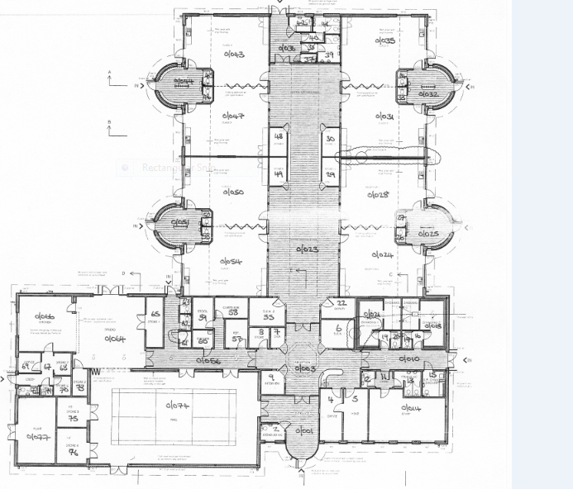
Mrs Brown
[Orange]
Miss Willis
[Blue]
Library
Rainbow Room
Mrs Derrick
[Green]
Mrs Vallely
Outdoor area
Miss Brown/
Mrs McQullian
[Yellow]
Mrs Vallely
[Purple]
Mrs Edwards/ Miss Brown
[Pink]
Mrs Tallent
(Red)

