Slide 1
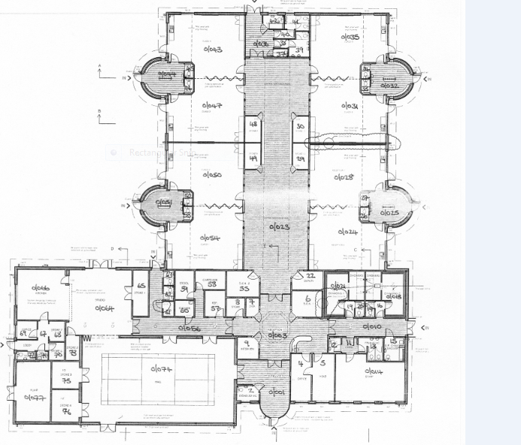
Mrs Brown
[Orange]
Miss Willis
[Blue]
Miss Brown/ Mrs McQuillan [Yellow]
Library
Mrs Derrick
[Green]
Rainbow Room
Outdoor area
Mrs Tallent
[Red]
Mrs Armstrong/Mrs Charlton [Lilac]
Mrs Edwards/ Miss Brown
[Pink]
Mrs Vallely
[Purple]

